Slide 1


TABLEAU– FINAL PROJECT Option 2 – Fifa18 Player Rating
Kingsley enwemiwe

Slide 2
PROJECT/GOALS
The project's objective is to conduct exploratory data analysis and visualization on the FIFA 2018 dataset using Tableau.
The goal is to uncover insights into player characteristics, determine factors influencing player ratings, and present the findings through an engaging dashboard.
This involves connecting the dataset, creating visualizations, and building a comprehensive dashboard to answer specific questions about player attributes and performance and communicate these insights effectively.

Slide 3
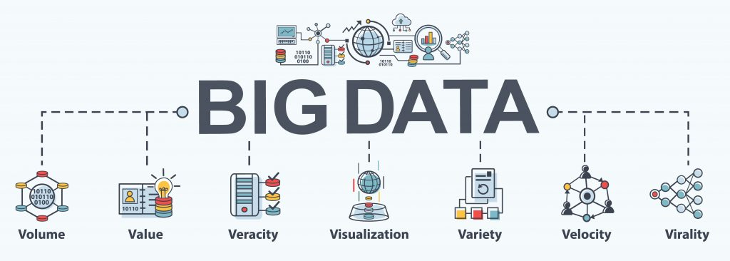
THE PROCESS
I connected the 'fifa18_clean.csv' dataset to Tableau for analysis, verified and corrected data types, and created five visualizations highlighting player distributions and positional analyses. Using correlation analysis, I identified influential features like 'Value,' 'Acceleration,' and 'Balance.’
For the final presentation, I designed compelling visuals, including maps and analytical forecasts. Delving into the data, I discovered outliers and trends, identifying key performance indicators. I crafted specific questions guiding the study and then synthesized the insights into a concise Tableau dashboard.

Slide 4
RESULTS
Nationality Distribution: A Map illustrating player counts from different nationalities, highlighting the diversity in the dataset.
Player wage analysis: Top 10 Highest Paying Club and Player wage showing outlier
Player overall rating : Histogram showing player composure with respect to their age.
Attribute Analysis: Players attribute analysis by country measured to average earnings.
Attribute Analysis: Top countries with the highest overall rating average.
Player value distribution: Line graph showing Player Age in relation to their Potential over time
Player value distribution: Line chart exploring trends over time - Comparing average player Wage and how it corresponds to Age.
Main Data Question: What factors contribute most to a player's overall rating? Their composure.
Dataset Selection: FIFA 2018 dataset with 70 attributes.
Features Explored: 'Value', 'Acceleration', 'Balance', 'Ball Control', and more.

Slide 5
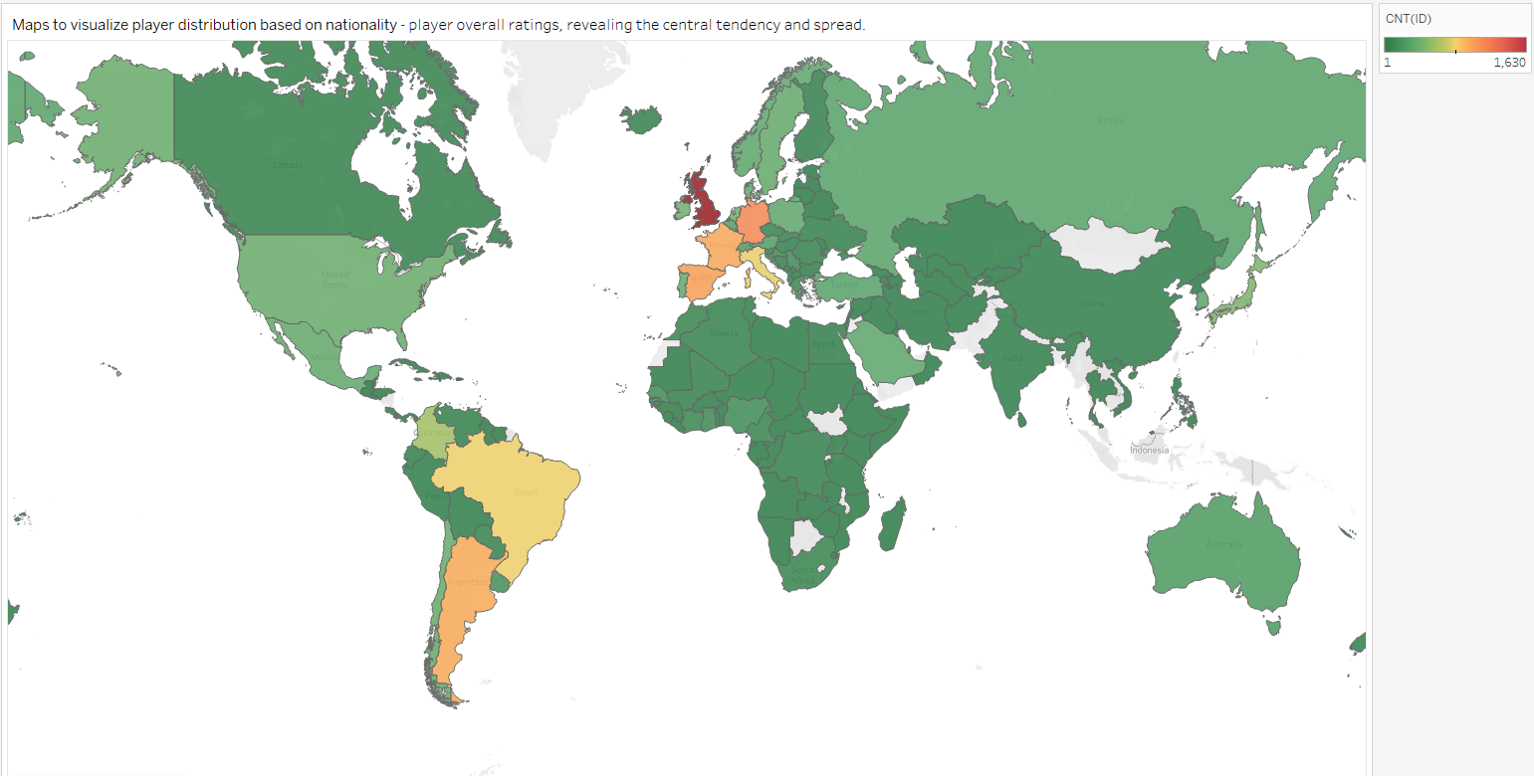
RESULT Nationality Distribution: A Map illustrating player counts from different nationalities, highlighting the diversity in the dataset.
LEGEND
Highest
Medium
Low

Slide 6
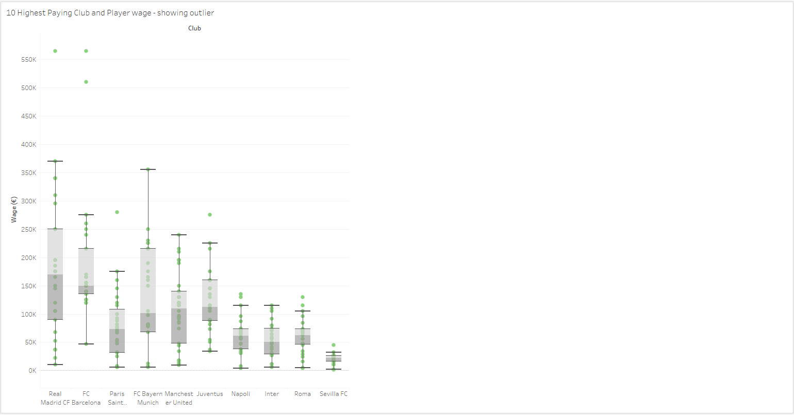
RESULT Player wage analysis: Top 10 Highest Paying Club and Player wage showing outlier

Slide 7
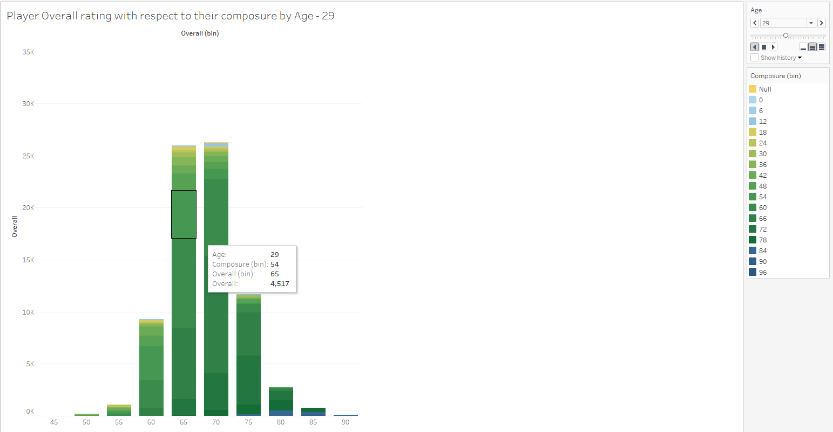
RESULT Player overall rating : Histogram showing player composure with respect to their age.

Slide 8
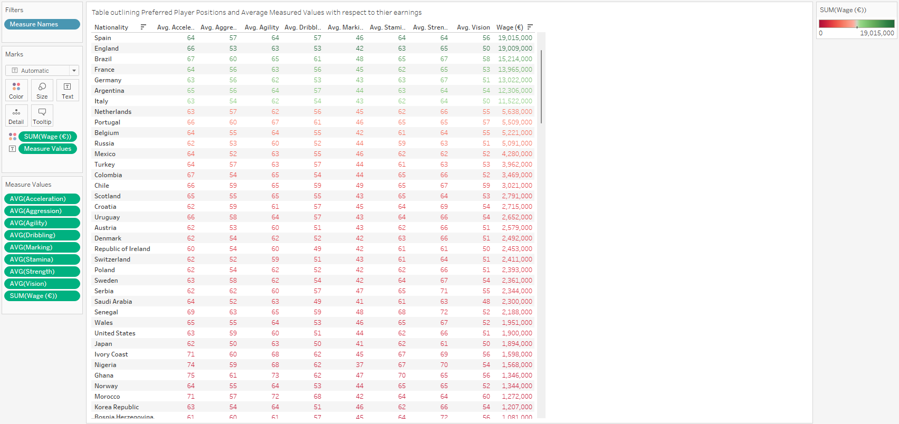
RESULT Attribute Analysis: Players attribute analysis by country measured to average earnings.

Slide 9
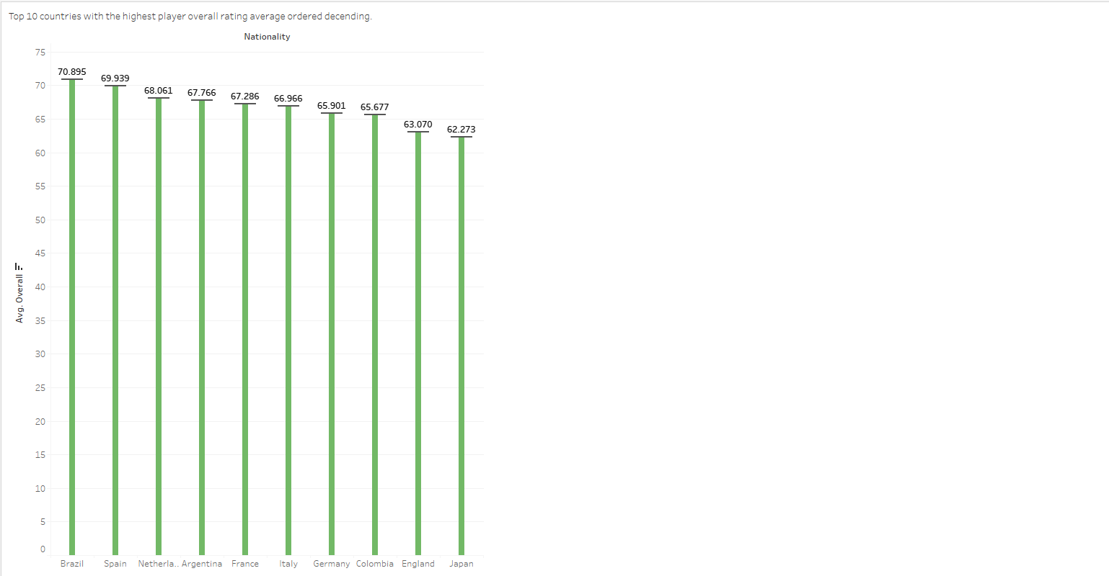
RESULT Attribute Analysis: Top countries with the highest overall rating average.

Slide 10
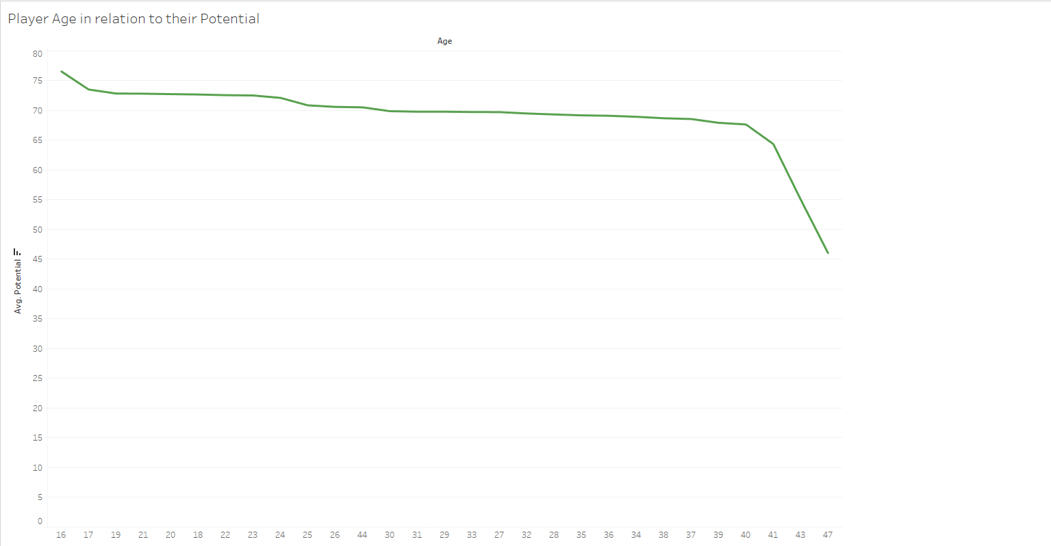
RESULT Player value distribution: Line graph showing Player Age in relation to their Potential over time

Slide 11
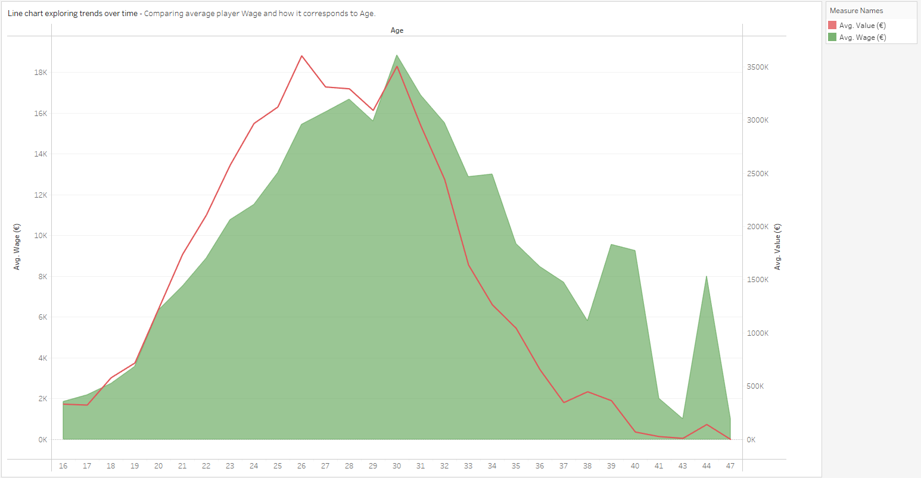
RESULT Player value distribution: Line chart exploring trends over time - Comparing average player Wage and how it corresponds to Age.

Slide 12
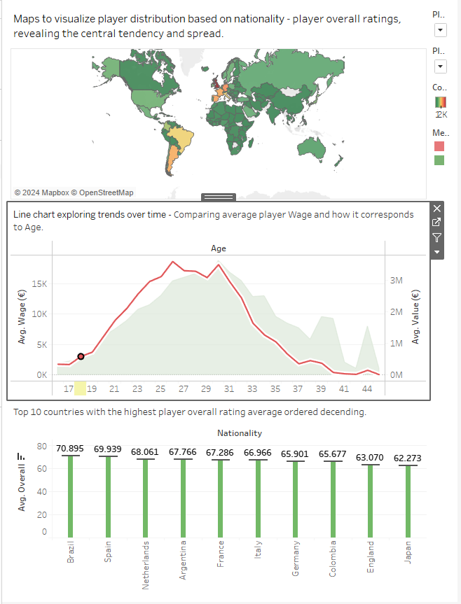
Dash Board Visualization

Slide 13

CHALLENGES
RATIONALE FOR VISUALIZATION
The visualizations were strategically selected to provide a comprehensive view of player attributes, distribution, and wage/value relationships. For example, the table outlining Preferred Player Positions and Average Measured Values with respect to wage earned, aimed to uncover nuanced relationships between attributes crucial for different player positions and also showing which player position earn higher wage.
The process was not without challenges. The data sheer size with 70 features presented the challenge of selection the most meaningful and impactful ones.
Ensuring data accuracy and addressing potential outliers demanded careful attention
Working with the large dataset ensuring data quality and also making sure to address missing values, an example was changing nationality data type from string to geographical/region. Also Some Nationality had unmatching location so I corrected that, example was countries (-England, Northern Ireland, Scotland, and Wales) are grouped in the United Kingdom.

Slide 14
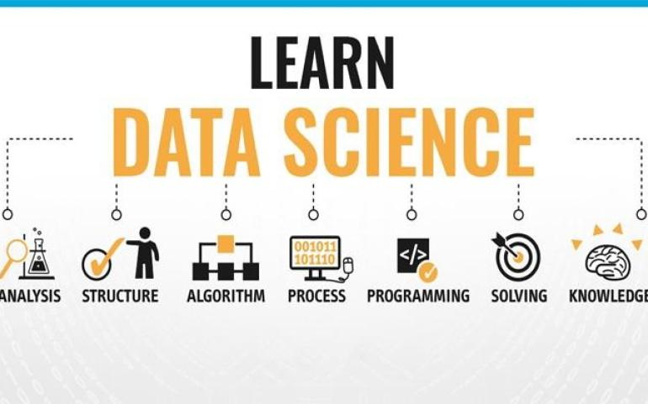
FUTURE GOALS
With additional time, I would delve deeper into forecasting analyses, exploring player groupings based on performance.
I would also conduct sentiment analysis on textual attributes, enriching my understanding of player characteristics beyond numerical values.
In conclusion, my perusal through the FIFA 2018 dataset has been insightful and enriching and made playing and watching score more interesting.
The carefully crafted visualizations and thoughtful analyses have paved the way for a detailed dashboard, encapsulating the essence of my exploration.

